Slide 1
Validating Estimates of Core and Transient Occupancy in North American Birds
Thesis proposal for the degree of Master of Science in Ecology
Molly F. Jenkins

Slide 2
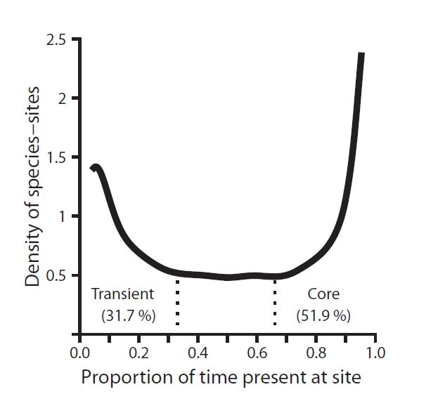
Background, Justifications, Motivations
“Core Transient” model of diversity
Descriptive community structure
Occupancy
NDVI, Elevation
Proxies for habitat heterogeneity
Predict richness, occupancy
At local vs landscape scale?
Figure credit: Coyle et al. 2013
Notes:
Bi-modal dist isn’t necessarily going to hold up across sites and taxa, because different taxa have different requirements in what is the appropriate area req for a “site”. Because occupancy is site dependent, because presence or absence is dependent on how large the place you are looking is, it is inherently scale dependent. We want to account for changes in scale to see if it explains variation in this bimodality, in our core-transient designations, and if accounted for, those designations still stand.

Slide 3
Hypotheses
Component 1: Investigate changes in temporal occupancy across scales
at scales below 40km (within Breeding Bird Survey (BBS) routes)
at landscape scales (sliding # of aggregated routes)
What variables influence occupancy at small, local scales? At large scales?
Environmental predictors, habitat heterogeneity
Notes:
Specifically: We expect mean occupancy i.e. incidence of core species to increase with larger spatial scales.
Greater scales capture a greater geographic range for avian taxa, which have high dispersal ability and may be more likely to occupy a larger range with consistency.
We also expect mean occupancy to shift downwards i.e. capture a greater incidence of transient species in more heterogeneous landscapes at larger spatial scales.
Differences in the sizes of BBS and BBC sites will reflect differences in occupancy between paired sites.

Slide 4
Hypotheses
Component 2: Investigate agreement between datasets
Expect validation of core-transient model
Pairing of BBS & Breeding Bird Census sites based on both:
Geographic distance
Environmental distance (distance in environmental space)
Differences in scale between BBS and BBC sites
Predict scale will explain variation or disagreement in temporal occupancy between paired sites

Slide 5

Datasets
Breeding Bird Survey (BBS):
Years 2000-2014
Within-route scale data availability
5000+, 40km roadside survey sites
Point counts
Breeding Bird Census (BBC):
1992/TBD
Non-random sample; plot size varied
Spot mapping
Image credit:
Patuxent Wildlife
Research Center

Slide 6
Component I: Methods
Temporal occupancy was derived by summing the presence (1) or absence (0) of a species at a given site for each year, and dividing it by 15 to render a proportion of years present for each species.
Average occupancy was recalculated from a fixed sample of sites across every scale.
Mean across species at each site
Mean across sites at a given focal route & scale => “Mean of means”
Variation in temporal occupancy:
i) at the scale of a BBS route
ii) at scales below a BBS route
Intervals along each route at the scale of 5, 10, 25, and full 50 Stop segments
iii) at scales above a BBS route => 1:66 routes aggregated

Slide 7
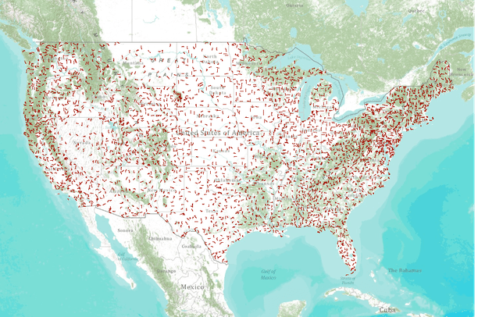
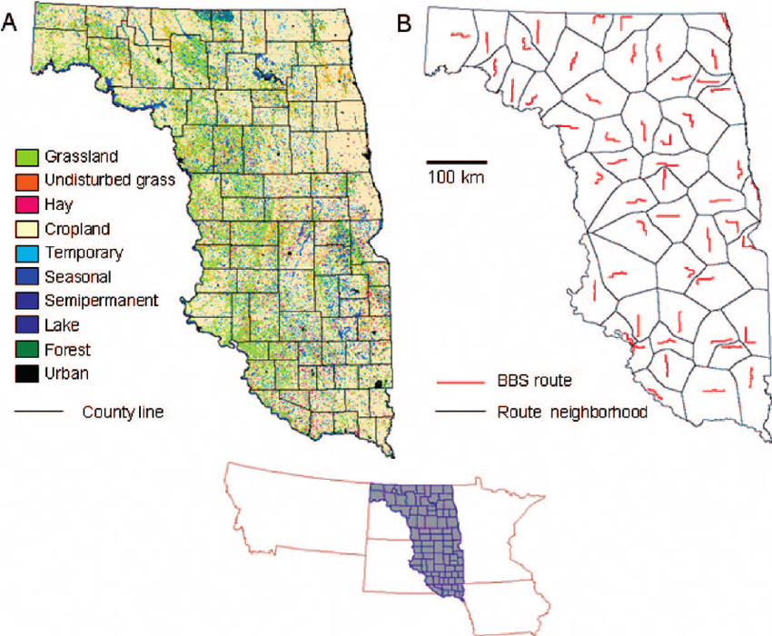
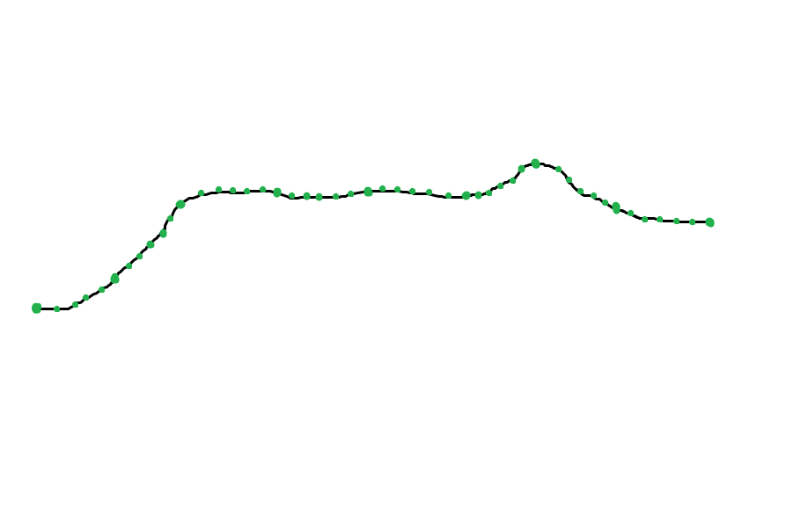
25 stops
25 stops
Mean Temporal Occupancy
Image credit: Conservation Biology Institute via DataBasin
Niemuth et al. 2007
1 BBS route: ~40km; 50 stops

Slide 8
Component I: Methods
Characterization of variance in occupancy-scale relationship across focal sites:
Variation explained by:
Environmental predictors? Habitat heterogeneity?
Precipitation, Temperature, Vegetation Indices (NDVI), Elevation
Occupancy ~ (area OR abundance) + (environmental variable)
Logistic: Mean Occupancy + % Core
Linear: % Transient

Slide 9
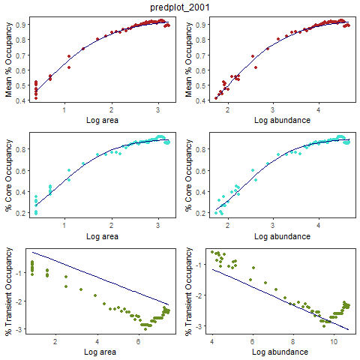
Notes:
A little grainy but still fun nonetheless. Curves were fitted using predicted values from logistic and linear model parameters.

Slide 10
Challenges: Component I
Regathering environmental raster data
Appropriate years or close to years investigated (2000-2014)
Elevational data expected to be best predictor
Still missing
Pairing environmental data to sites
Only have lat-lons for single full BBS routes
Currently using “buffer” option in extracting raster data
Characterizing by mean/variance across cells associated w/sites
Still presents problems with the within-route data
Characterize habitat along a full route?

Slide 11
Hypotheses
Component 2: Investigate agreement between datasets
Expect validation of core-transient model
Pairing of BBS & Breeding Bird Census sites based on both:
Geographic distance
Environmental distance (distance in environmental space)
Differences in scale between BBS and BBC sites
Predict scale will explain variation or disagreement in temporal occupancy between paired sites

Slide 12
Component II: Proposed Methods
Comparing species designations of core and transient
Cross dataset validation
Geographic distance pairing
Minimum distance between sites using great circle distance
Sites also binned by area
Environmental distance pairing
Environmental raster data (Temp, Precip, Elev, NDVI)
Assigned to coordinates of each site
Z scores calculated from variables and assigned to sites
Sites paired by minimum difference in z score
Again, sites binned by area
Frequency of agreement in occupancy between datasets

Slide 13
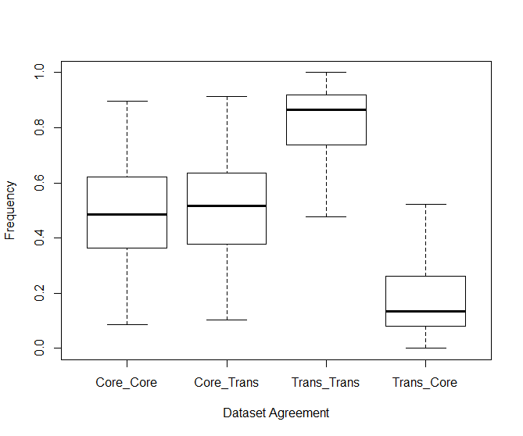
Component II: Preliminary Results
I
I I
Notes:
Results from preliminary analyses pairing nearest BBS and BBC site by nearest geographic distance, but without accounting for differing areas or abundances between sites.

Slide 14
Predictions: Component II
Revised analysis pairing sites binned by scale
Scale + environmental variables:
Explain discrepancies in dataset agreement
Help identify rare core species, and common transient species?

Slide 15
Challenges: Component II
Unsure how to best pair BBC and BBS sites across years + scales
Corresponding years available?
Corresponding minimum difference in scales
Area/abundance binning

Slide 16
Future project objectives
Complete data analysis by end of July 2017
Complete a full 2nd draft of thesis by end of Spring 2017
3rd draft by end of July 2017
New draft every month thereafter
Secure written comprehensives exam date (early Fall 2017)
Secure defense date (late Fall 2017)

Slide 17
Feedback & Questions

